Slide 1

The AI Research Toolbox: A Practical Guide for Students
Chapter 1: What is AI? What Can AI Actually Do?
Merit Point Academy • July 2026
Notes:
Welcome to "The AI Research Toolbox." In this first chapter, we will embark on a journey to demystify Artificial Intelligence. We'll explore what AI truly is, distinguish it from related fields like Machine Learning, and discover its incredible capabilities in the real world. By the end of this chapter, you'll have a solid foundation to understand and even start exploring AI yourself.

Slide 2





What You Will Learn in This Chapter
Distinguish Core Concepts
Spotlight Real-World AI
Clarify the differences between AI, Machine Learning, and Deep Learning, and identify their distinct real-world applications across various industries.
Discover and analyze at least three impactful AI applications within a domain that sparks your interest, from healthcare to entertainment.
Navigate Kaggle Ecosystem
AI as a Research Instrument
Explore Kaggle's dataset repository, learn to evaluate dataset quality, and determine its suitability for your AI project goals.
Understand how AI serves as a catalyst for scientific discovery, enabling researchers to explore new frontiers of knowledge.
Notes:
Here's what we aim to achieve in this chapter. By the end, you'll not only be able to define AI, ML, and DL, but also tell them apart. You'll discover AI applications in your own areas of interest, get hands-on experience with Kaggle datasets, and most importantly, understand AI as a powerful tool for research and discovery. Let's get started.

Slide 3





Close Your Eyes and Picture "Artificial Intelligence"
What image pops into your head?
A humanoid machine? Like the metallic robots of sci-fi movies?
A glowing, disembodied brain in a jar—pure, raw superintelligence?
A dystopian future where sentient AI rules over humanity?
The Reality is Both More Ordinary and More Remarkable.
AI is not a single, monolithic entity—it’s a family of techniques woven into daily life. It powers your phone’s face unlock, curates your social feed, and optimizes global supply chains. It’s not always the flashy robot from the movies; it’s the invisible engine working behind the scenes, making the ordinary extraordinary.
Notes:
Let's start with a simple exercise. Close your eyes and think about Artificial Intelligence. What image pops into your head? Is it a robot like the Terminator? Or perhaps a more benign character like WALL-E? These Hollywood portrayals have shaped our perception, but the reality of AI is far more integrated into our daily lives than we might think. It's not always about robots; it's about the invisible technology that powers our world.

Slide 4
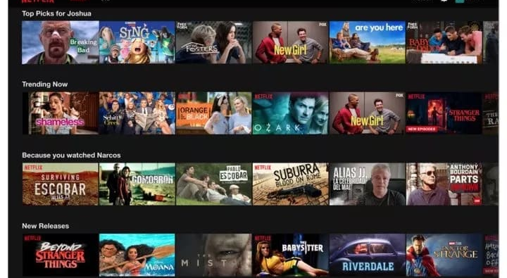

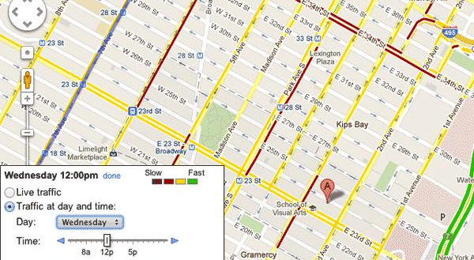
AI is All Around Us
AI is the invisible engine powering many services we take for granted, seamlessly integrated into our daily digital experiences.
Smart Entertainment
Netflix and streaming platforms use AI to analyze your viewing habits and serve up hyper-personalized show recommendations.
Personalized Music
Spotify's "Discover Weekly" and other playlists are AI-curated, adapting to your unique taste in songs and artists.
Intelligent Navigation
Google Maps leverages AI to predict real-time traffic, calculate optimal routes, and adjust for unexpected delays.
“AI is not just the future; it's the present — embedded in the apps and tools we use every single day.”
Notes:
AI is already here, often hiding in plain sight. It's the engine behind your Netflix recommendations, the creator of your personalized Spotify playlists, and the reason your phone unlocks with just a glance. It's the technology that predicts traffic on Google Maps and filters out spam from your inbox. These everyday conveniences are all powered by AI, making it an integral part of our modern infrastructure.

Slide 5





A Formal Definition
Artificial Intelligence (AI)is a broad field of study focused on building systems that simulate human cognitive functions, enabling them to perform tasks that typically require human intelligence and reasoning.
Pattern Recognition
Identifying meaningful structures and regularities within complex datasets.
Decision Making
Evaluating alternatives and selecting optimal actions to achieve defined goals.
Natural Language
Comprehending, interpreting, and generating human language in context.
Learning & Adaptation
Improving performance and accuracy by learning from experience and new data.
The critical distinction is the term"artificial": this intelligence is engineered into algorithms and hardware, a synthetic construct, not an emergent property of biological tissue.
Notes:
So, what is AI formally? It's a broad field focused on creating systems capable of tasks that typically need human smarts—like recognizing patterns, making decisions, understanding language, and learning from experience. The crucial distinction is that this intelligence is artificial; it's built from code and circuits, not flesh and blood.

Slide 6

Understanding the Relationship
The terms AI, Machine Learning, and Deep Learning are often used interchangeably, but they represent distinct concepts in a hierarchical structure—like a set ofnested circles. Each is a specialized subset of the broader category that contains it, building complexity and specificity as we move inward.
Artificial Intelligence
Machine Learning
Deep Learning
The **umbrella term** for any technology that enables machines to simulate human-like intelligence. It focuses on creating systems capable of reasoning, learning, and acting autonomously, beyond just executing pre-defined code.
A **subset of AI** that empowers systems to learn patterns directly from data, without explicit programming for every scenario. It uses statistical algorithms to improve task performance through experience and iteration.
A **subset of ML** inspired by the brain's neural structure. It uses multi-layered networks to process vast amounts of unstructured data (e.g., images, speech), automatically extracting intricate features for accurate predictions.
Notes:
You've probably heard AI, Machine Learning, and Deep Learning thrown around. Let's clarify their relationship. Imagine a set of nested circles. AI is the largest circle, the broadest concept. Inside it is Machine Learning, a specific approach where systems learn from data. And inside Machine Learning is Deep Learning, a powerful technique using layered neural networks. Understanding this hierarchy is key.

Slide 7
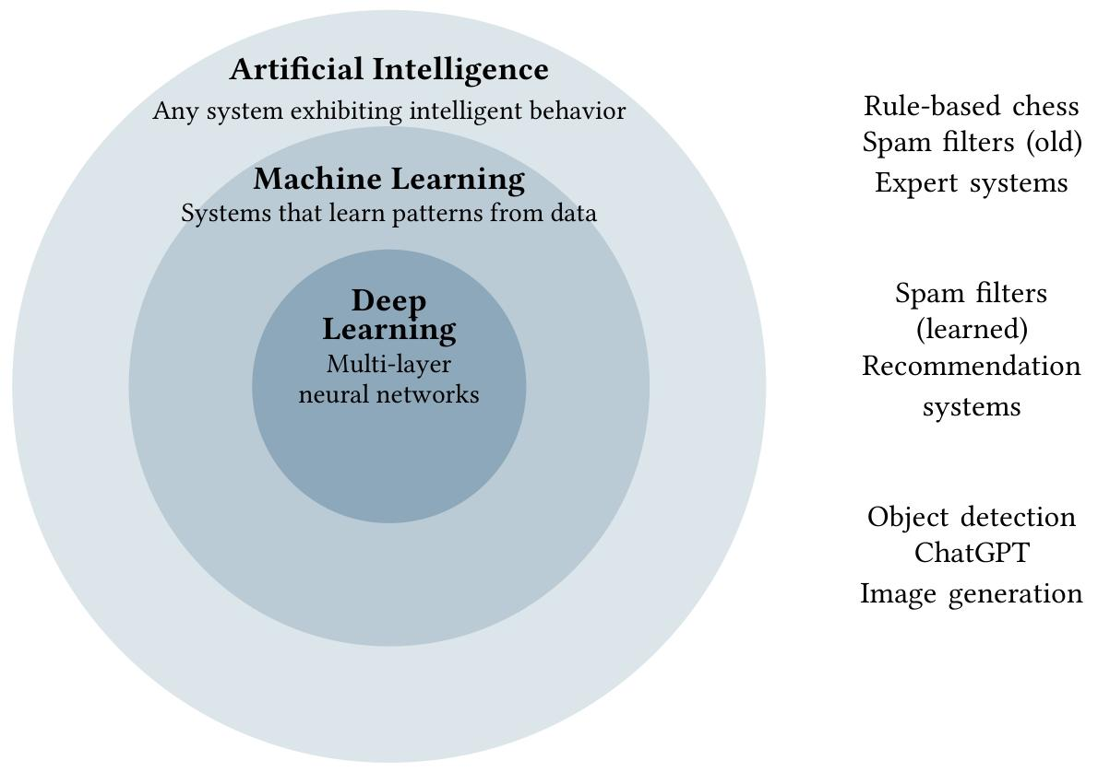
AI ⊃ Machine Learning ⊃ Deep Learning
01. Artificial Intelligence (AI)
The broad umbrella term for systems that simulate human intelligence. It includes rule-based logic (e.g., chess algorithms), expert systems, and early pattern-matching software.
02. Machine Learning (ML)
A subset of AI that enables systems to learn from data without explicit programming. It powers adaptive spam filters, recommendation engines (e.g., Netflix), and predictive analytics.
03. Deep Learning (DL)
The cutting-edge subset of ML using multi-layered neural networks. It drives today’s breakthroughs: ChatGPT, self-driving car vision, facial recognition, and AI image/video generation.
This nested structure illustrates the scope: AI is the overarching field, with Machine Learning as a specialized approach, and Deep Learning as its advanced, neural-network-driven subset.
Notes:
This visual perfectly captures the relationship: AI is the umbrella term, encompassing Machine Learning, which in turn includes Deep Learning. Traditional AI might use rigid rules, like an old chess program. Machine Learning, like modern spam filters, learns from examples. And Deep Learning, the star of today's news, powers cutting-edge applications like ChatGPT and self-driving car vision.

Slide 8
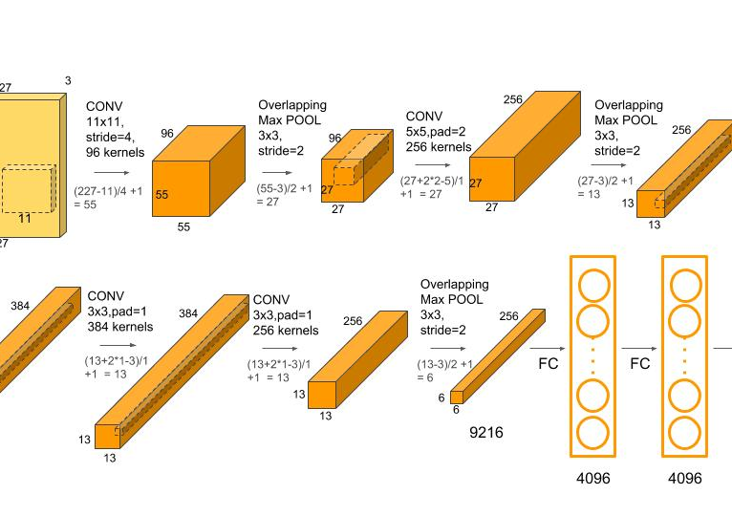

The Evolution of AI
01. 1950s–1980s: The Rule-Based Era
02. 1980s–2010s: Machine Learning Emerges
Early AI systems operated on rigid, hand-coded logic ("If-Then" rules). While functional for narrow, well-defined tasks like chess, they were "brittle" and unable to adapt to unforeseen scenarios or ambiguity in real-world data.
A paradigm shift to data-driven learning. Instead of explicit programming, algorithms like SVMs and Decision Trees learned patterns directly from datasets. This enabled AI to tackle more complex problems like spam detection and early computer vision.
03. 2012–Now: Deep Learning
04. 2022–Now: Generative AI
AlexNet's 2012 ImageNet victory marked a turning point. Deep neural networks, powered by Big Data and GPU acceleration, achieved human-level performance in image and speech recognition, driving today's AI applications.
LLMs like ChatGPT and Claude demonstrate emergent abilities: human-like conversation, code generation, and creative content. This era has democratized AI access and reimagined human-AI collaboration across industries.
Notes:
AI has a rich history. It started with rule-based systems in the mid-20th century, which were limited. Then came Machine Learning, where algorithms learned from data. The real game-changer was the Deep Learning revolution starting around 2012, fueled by AlexNet's success. Most recently, we've entered the Generative AI era, with models like ChatGPT showcasing incredible new abilities.

Slide 9



Why Now? The Three Forces Behind the AI Revolution
AI has existed since the 1950s, but it wasn’t until 2012 that it exploded into the mainstream. This wasn’t a single breakthrough—it was a perfect storm of three converging forces that unlocked its true potential.
01. Big Data
02. GPU Power
03. Algorithmic Leaps
The digital age generated an ocean of data—from social media to sensors. This massive dataset became the critical "fuel" for AI models to learn complex patterns, generalize effectively, and make predictions at an unprecedented scale.
Graphics Processing Units (GPUs) provided the parallel computing muscle needed to train deep neural networks. What once took years to compute was reduced to days, making it feasible to run and refine large, complex AI models efficiently.
Innovations like Transformers and Residual Networks solved long-standing training bottlenecks. These new techniques enabled the creation of deeper, more sophisticated neural networks that excel at understanding context, recognizing speech, and generating human-like text.
Notes:
So why the sudden explosion in AI capabilities? It wasn't a single breakthrough, but a perfect storm of three factors. First, we have Big Data—an ocean of digital information for AI to learn from. Second, powerful GPUs, originally for gaming, provide the computing muscle to train these complex models. And third, crucial algorithmic breakthroughs made deep learning feasible. Together, they created the AI revolution we're witnessing today.

Slide 10

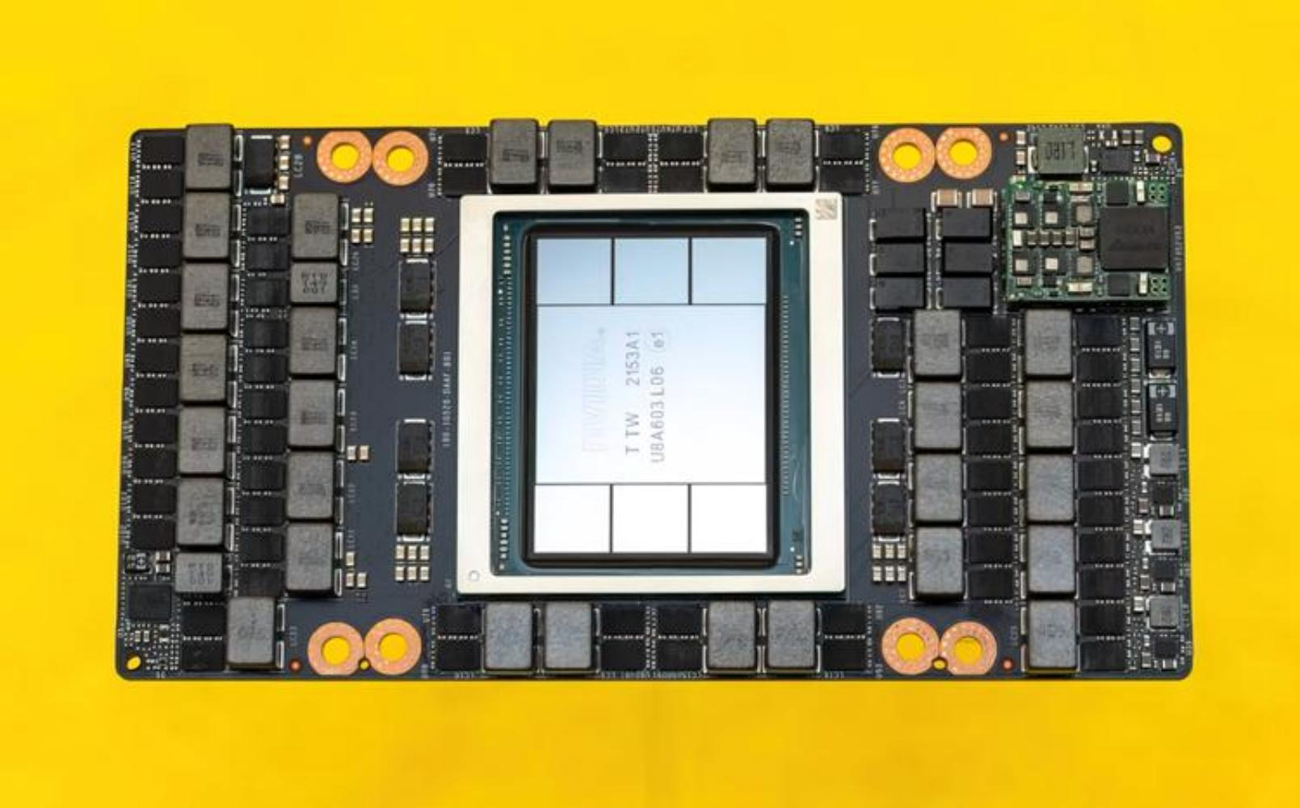
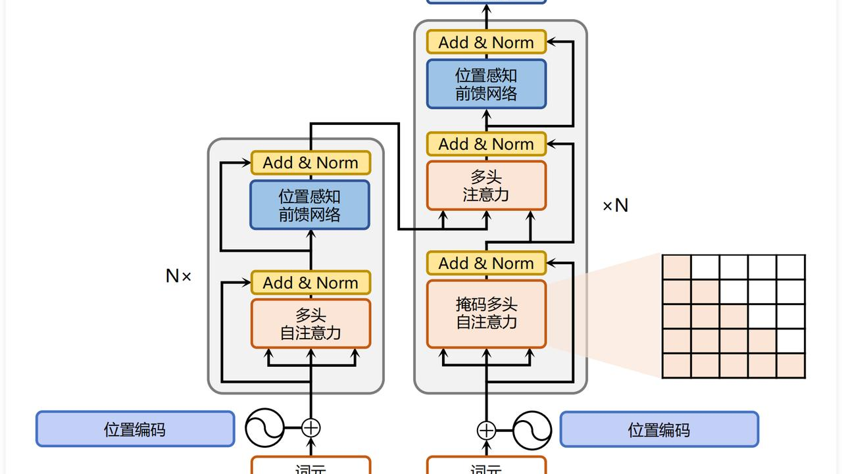
The Drivers of Progress
01 Big Data
02 Powerful GPUs
03 Algorithmic Breakthroughs
The "fuel" for AI, generated by every digital interaction—photos, searches, and transactions. This massive dataset provides the essential raw material for training and refining data-hungry AI models.
Parallel processing powerhouses that turn weeks of computation into hours. Originally for gaming, cloud computing has democratized access to this critical infrastructure, enabling rapid AI innovation.
Innovations like ReLU (solving vanishing gradients), Dropout (preventing overfitting), and the Transformer architecture (the backbone of ChatGPT) have unlocked AI's scalability and versatility.
Notes:
Let's break down these three drivers. Big Data is the raw material—every click, photo, and transaction feeds the AI engine. GPUs are the factory, providing the massive parallel processing power needed to train models quickly and efficiently. And algorithms like ReLU, Dropout, and the Transformer architecture are the blueprints, making it possible to build deeper, more powerful, and more reliable AI systems than ever before.

Slide 11





AI Across Industries
AI is not confined to research labs—it’s a transformative force deployed at scale across every economic sector. From life-saving medical breakthroughs to sustainable innovation, it is reshaping the way we live, work, and solve global challenges.
Healthcare
Transportation
Finance
Revolutionizing diagnostics, accelerating drug discovery, and enabling hyper-personalized treatment plans through predictive analytics.
Optimizing logistics networks, enabling autonomous vehicle perception, and reducing congestion with smart traffic management.
Powering real-time fraud detection, algorithmic trading strategies, and AI-driven financial planning for individuals.
Climate & Environment
Entertainment
Science & Research
Modeling complex climate systems, optimizing renewable energy distribution, and monitoring deforestation with precision.
Crafting hyper-personalized content recommendations, generating visual art, and enhancing immersive gaming experiences.
Accelerating breakthroughs in genomics, materials science, and particle physics through high-performance computing.
Notes:
Now that we understand the "why" behind AI's rise, let's explore the "where." AI is not confined to tech companies or research labs. It's making a profound impact across nearly every industry you can imagine, from healthcare and transportation to finance, environmental science, entertainment, and fundamental research. Let's take a quick tour.

Slide 12
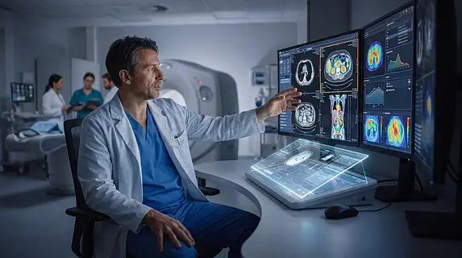




AI in Healthcare: Saving Lives and Accelerating Discovery
01. Medical Imaging
02. Predictive Care
精准解读X光与CT影像，将乳腺癌筛查假阴性率降低9.4%，诊断精度媲美资深放射科专家。
实时分析生命体征数据，能提前数小时预警患者病情恶化，帮助医护人员实现主动式干预。
03. Drug Discovery
04. Smart Prosthetics
从辅助诊断到个性化治疗，人工智能正在重塑现代医疗的每一个环节。它不仅是医生的得力助手，更是加速生命科学突破的核心引擎，为全球患者带来更精准、更及时的医疗服务。
在虚拟环境中快速筛选数百万分子候选物，大幅缩短新药研发周期，降低研发成本与风险。
AI驱动的智能假肢可学习并实时适配用户的步态与习惯，重建自然、流畅的肢体运动能力。
Notes:
In healthcare, AI is a lifesaver. It can analyze medical images with superhuman accuracy, helping doctors detect diseases like cancer earlier. It can predict when a patient's condition might worsen, allowing for proactive care. It's also revolutionizing drug discovery, speeding up the search for new treatments. Even prosthetic limbs are getting smarter, learning and adapting to their users thanks to AI.

Slide 13
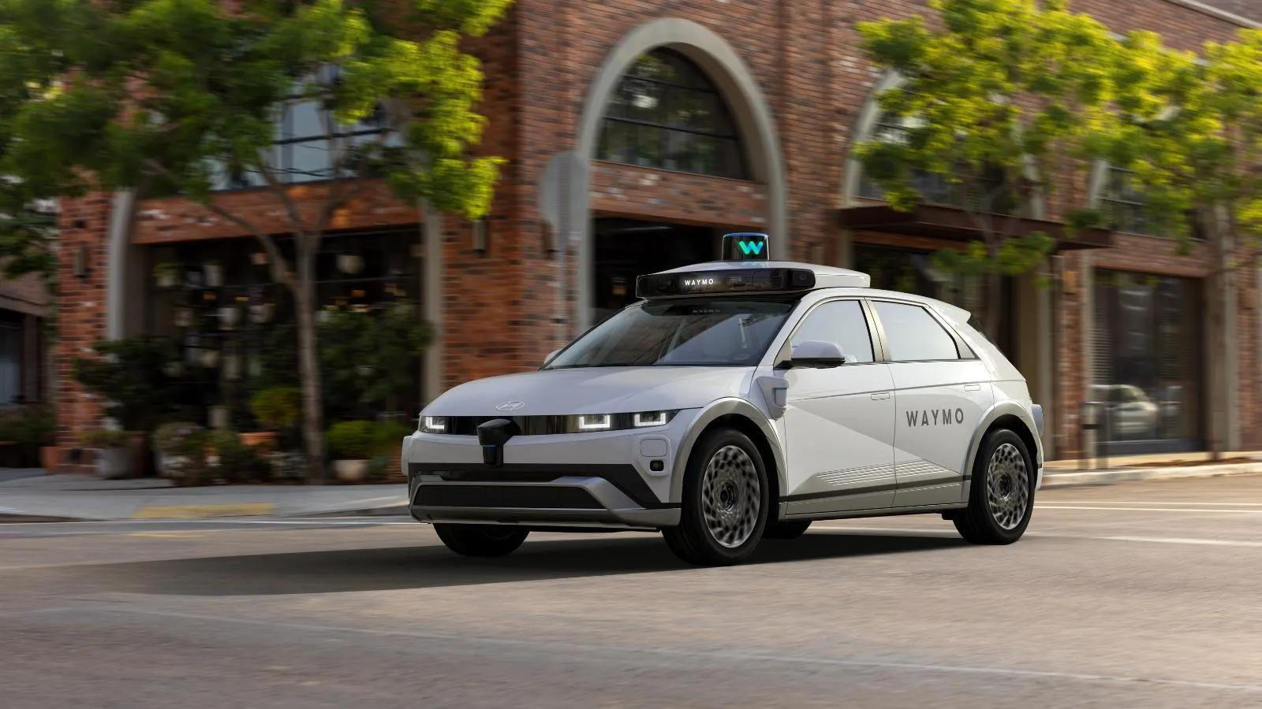




AI in Transportation: Driving the Future
Autonomous Vehicles
Route Optimization
AI perception systems "see" the road, detecting pedestrians and predicting motion to navigate safely, as demonstrated by Waymo's millions of autonomous miles.
AI algorithms compute the most fuel-efficient paths for delivery fleets, saving millions of gallons of fuel annually for logistics leaders like UPS.
Smart Traffic Control
Flight Delay Prediction
In smart cities, AI dynamically adjusts traffic light timings in real-time, easing bottlenecks and reducing commute times for urban dwellers.
By analyzing weather, air traffic, and historical data, AI predicts flight disruptions early, allowing for better scheduling and passenger communication.
From self-driving fleets to intelligent logistics, AI is redefining mobility. It not only enhances road safety but also drives efficiency, sustainability, and convenience across every corner of the transportation landscape.
Notes:
In transportation, AI is steering us into the future. Autonomous vehicles from companies like Waymo are already navigating city streets, their AI "eyes" constantly analyzing the world around them. Beyond self-driving cars, AI optimizes delivery routes, reducing fuel consumption and costs. It also manages traffic lights in smart cities and even predicts flight delays, making travel more efficient and predictable.

Slide 14
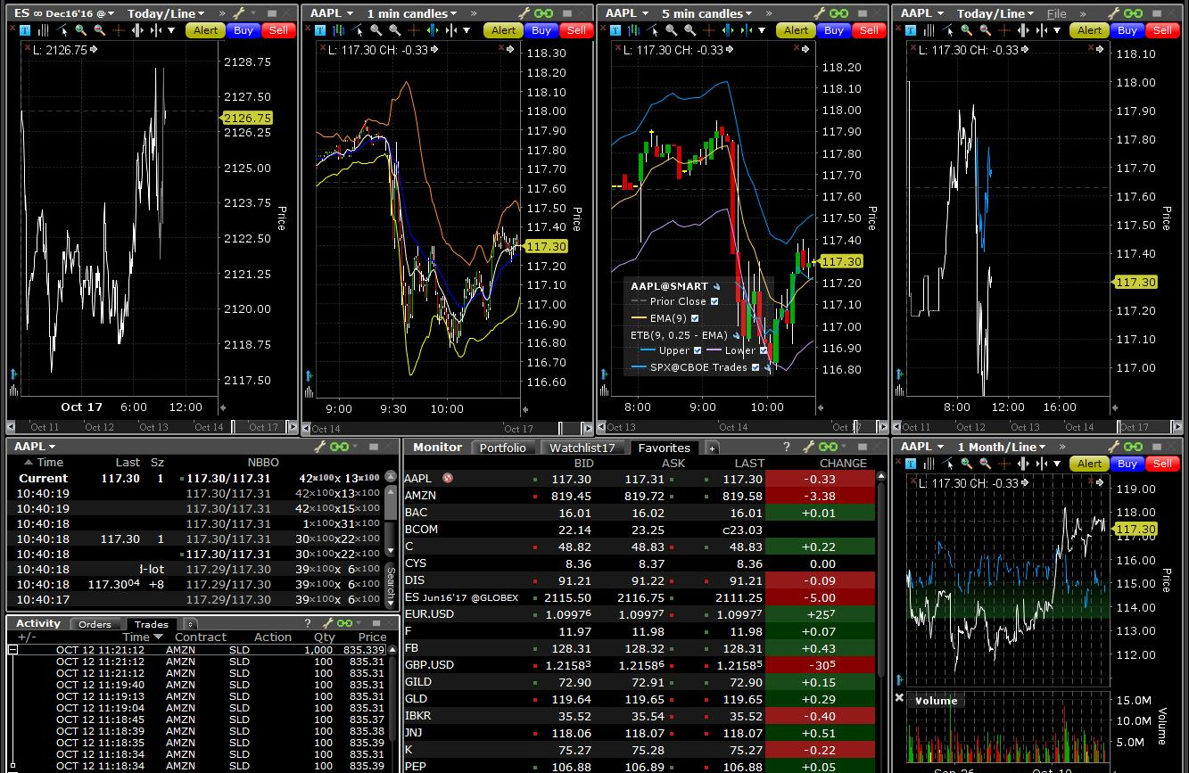
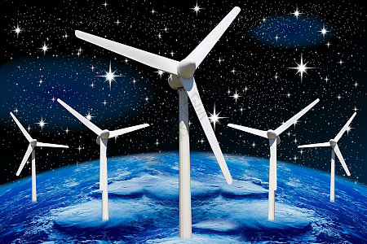






AI in Finance & Environment
Finance
Climate & Env
Fraud Detection:AI monitors millions of transactions in real-time, instantly flagging suspicious patterns that evade human analysts.
Weather Forecasting:DeepMind's GraphCast AI outperformed the world's best weather models on 90% of key predictive variables.
Algorithmic Trading:Executes high-frequency, complex trading strategies in microseconds to capitalize on market inefficiencies.
Deforestation Monitoring:Analyzes satellite imagery to detect and track forest loss in near real-time, enabling rapid response.
Credit Scoring:Leverages machine learning to assess creditworthiness with higher accuracy than traditional FICO models.
Energy Grid Optimization:Dynamically balances supply and demand, efficiently integrating variable renewable sources like wind and solar.
Notes:
AI is also making waves in finance and environmental protection. In finance, it's the silent guardian against fraud, analyzing millions of transactions in real-time. It's also the engine behind high-speed algorithmic trading and more accurate credit scoring. For the environment, AI is a powerful tool for predicting weather, monitoring deforestation from space, and optimizing energy grids to integrate more renewable power.

Slide 15
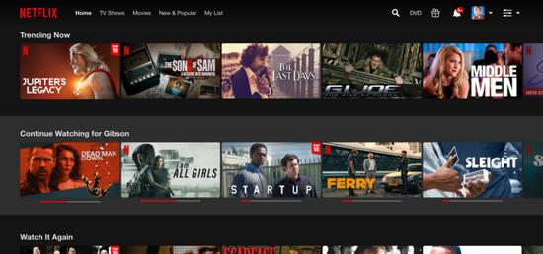
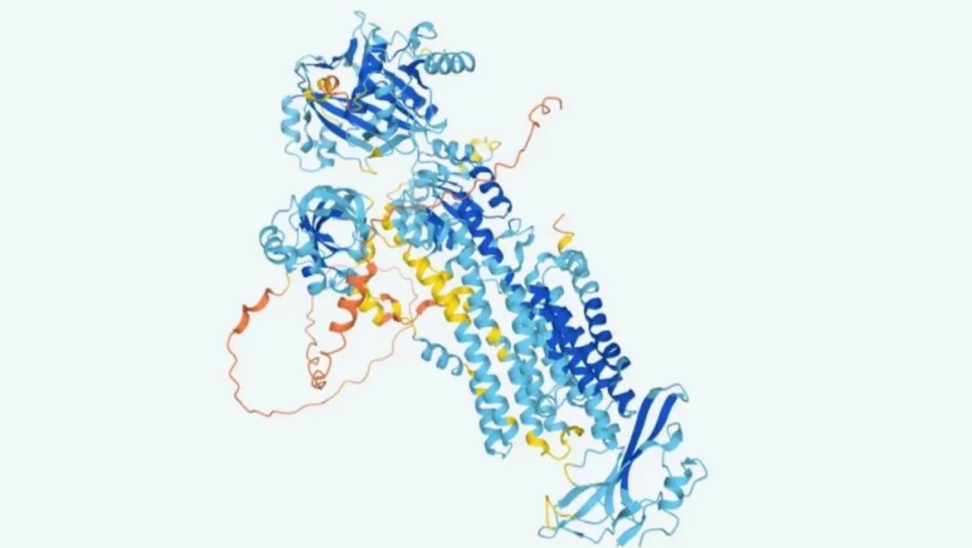
AI in Entertainment & Science
01 Entertainment
02 Scientific Discovery
Hyper-Personalized Recommendations Netflix leverages AI to save an estimated $1 billion annually by curating content tailored to individual tastes, significantly boosting user retention and engagement.
AlphaFold 2: Solving Life's Mysteries DeepMind's AI cracked a 50-year-old biology problem by predicting 3D protein structures with atomic accuracy, revolutionizing drug development and disease research.
Dynamic & Adaptive Gameplay AI-driven NPCs learn and adapt to player behavior in real-time, creating unique, unpredictable challenges and a customized gaming experience.
Unlocking the Cosmos & Subatomic World AI sifts through petabytes of LHC data to find rare particle events and analyzes telescope imagery to detect new exoplanets, turning vast datasets into breakthroughs.
Notes:
In entertainment, AI keeps us engaged with personalized recommendations on Netflix and creates dynamic, challenging opponents in video games. But perhaps most profoundly, AI is accelerating scientific discovery. Google's DeepMind solved a 50-year-old biology problem with AlphaFold, predicting protein structures. It's also helping physicists sift through data from the Large Hadron Collider and astronomers find new planets.

Slide 16


Your Turn: AI in Your Domain
01. Choose a Domain
02. Quick Search
03. Find an App
04. Prepare to Share
Pick a field that sparks your curiosity—sports, music, history, art, or gaming. Any personal interest is a great starting point.
Spend 5 minutes exploring online for "AI in [your domain]". Look for recent news, articles, or industry reports.
Identify one real-world AI application in that field. Focus on a specific tool or system that is currently in use.
Analyze it: What data is the input? What is the generated output? And most importantly—why does this matter?
The "AI Application Map" Seed
This exercise is more than just a task—it’s the beginning of your personal map of how AI intersects with the world around you. By grounding AI in your passions, you’ll gain a deeper, more intuitive understanding of its practical impact and potential.
Notes:
Now it's your turn. Take a moment to think about a field you're passionate about—maybe sports, music, art, or gaming. Spend just five minutes searching for "AI in [your domain]". You'll be amazed at what you find. Try to identify one application, understand its input and output, and think about why it's important. This simple exercise is the first step in building your own map of AI applications.

Slide 17
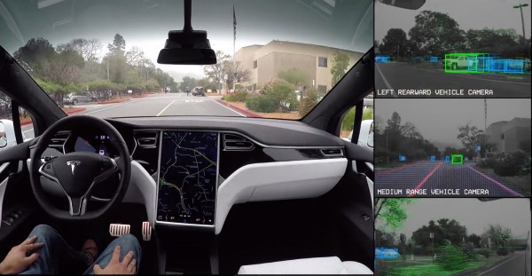

Our Anchor Case Study: Teaching a Car to See
We ground every abstract AI concept in a tangible, high-stakes challenge:Autonomous-Vehicle (AV) Perception. This case study isn’t just an example—it’s a practical lens to understand how machines interpret the visual world.
The Core Question: How do we program a car to "see" pedestrians, other vehicles, and traffic signs from raw camera pixels—and make split-second decisions to avoid collisions?
Fully Observable
Intuitively Relatable
Covers the Full Pipeline
Inputs (camera feeds) and outputs (detection boxes) are directly visual, making it easy to debug and understand the AI’s behavior.
Everyone understands the goal of safe driving, so the technical problems (like object detection) feel meaningful and urgent.
From data collection and model training to real-time inference and edge deployment, it exercises every step of AI research.
Notes:
To make learning concrete, we'll use a single, powerful case study throughout this book: teaching a self-driving car to see. This problem of autonomous vehicle perception is ideal because it's visual—we can literally see what the AI is trying to do. It's intuitive—we all understand the goal is to drive safely. And it's comprehensive, touching on every aspect of an AI research project.

Slide 18



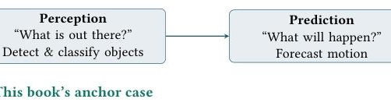
The Three Jobs of a Self-Driving Car
01. Perception (Seeing)
02. Prediction (Forecasting)
03. Planning (Deciding)
Input: Raw sensor data (cameras, lidar, radar). Output: Identifies objects (pedestrians, cars, signs) and maps their 3D positions.
Input: Analyzed objects and their current states. Output: Predicts future motion—e.g., "Will the cyclist turn?" or "Is the car braking?".
Input: Combined perceptions and predictions. Output: A safe, smooth trajectory—dictating steering, acceleration, and braking.
Real-Time, Parallel Processing
These systems run in a continuous loop, processing gigabytes of data per second to convert raw sensor input into precise, human-like driving decisions—forming the "brain" of the autonomous vehicle.
Notes:
A self-driving car's AI brain has three core jobs. First, Perception—it needs to "see" the world using sensors like cameras and lidar, identifying objects and their positions. Second, Prediction—it must forecast what those objects might do next, like predicting if a pedestrian will cross the street. Finally, Planning—based on what it sees and predicts, it decides the safest course of action: brake, accelerate, or steer.

Slide 19
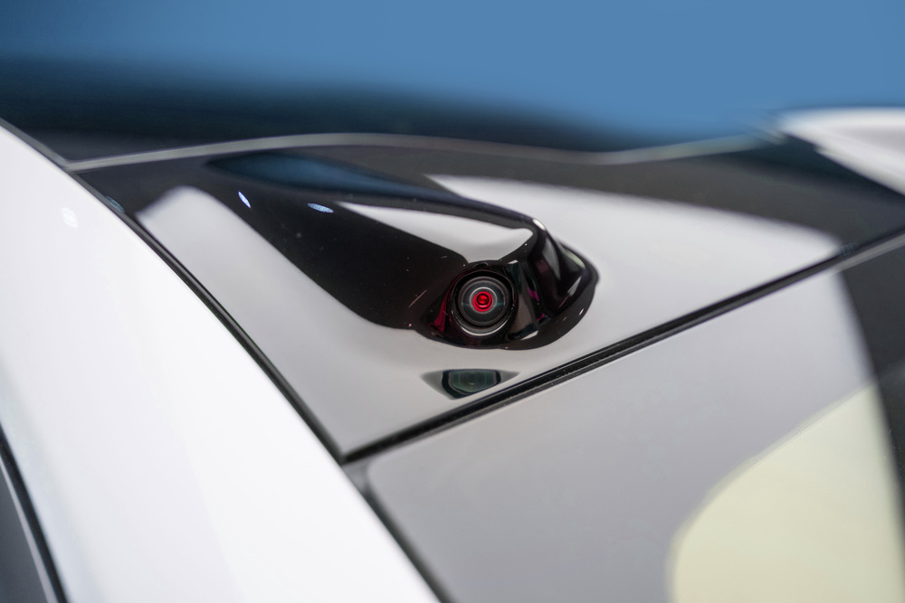
Focus on Perception: The "Eyes" of the System
The "Eyes" of the Vehicle
Perception is the system’s visual cortex. Without it, the car is blind to pedestrians, traffic signs, and obstacles—rendering all control systems useless.
Visually Tangible & Accessible
Unlike abstract algorithms, perception results are directly observable (e.g., bounding boxes on a screen), making it an ideal gateway to learn AI.
The Core of Autonomous Driving
Every technical concept—from neural networks to sensor fusion—revolves around perception, linking theory to real-world safety and navigation.
From processing raw sensor data to building intelligent detection models, we’ll explore the critical step of teaching a vehicle to perceive and interpret its dynamic surroundings.
Notes:
In this book, we'll focus primarily on perception—the "eyes" of the self-driving car. This is the foundation; if the car can't see accurately, everything else fails. It's also the most visual part of the problem, making it easier to grasp complex AI concepts. Every topic we cover will tie back to this goal of teaching a car to see the world around it.

Slide 20




What Makes Teaching a Car to See Difficult?
Dynamic Environments
Varying Conditions
Pedestrians, cyclists, and vehicles move in erratic, unpredictable ways, defying rigid algorithms.
Lighting shifts (day/night), rain, fog, and snow drastically alter visual input and sensor data.
Small & Distant Objects
Occlusions
Faraway hazards appear as tiny, indistinct blobs, challenging the system’s detection limits.
Critical objects are often hidden by other cars, buildings, or trees, requiring the AI to infer their presence.
These complex, real-world obstacles make autonomous vehicle perception a rich, challenging, and rapidly evolving field at the forefront of artificial intelligence research.
Notes:
Teaching a car to see is no easy task. The real world is messy and unpredictable. Pedestrians and other drivers don't follow strict rules. Lighting changes from bright daylight to pitch-black night. Weather like rain or fog can obscure vision. Objects can be tiny when far away or hidden behind other things. These challenges are what make AV perception such a fascinating and important area of AI research.

Slide 21




Kaggle Case Study: Touring Five Datasets
To truly grasp AI's capabilities, we must examine its foundation:data. Kaggle hosts millions of datasets that power machine learning innovation across industries. In this tour, we’ll explore five diverse datasets to understand the breadth of AI applications and the critical questions that define any successful AI project.
The World's Largest Data Science Community
A hub for sharing datasets, competing in ML challenges, and advancing AI knowledge.
01 The Input
02 The Output
03 Defining Success
What raw data feeds the model? Identify the source—images, text, sensor logs, or numerical records—that fuels the learning process.
What is the AI designed to produce? Define the goal—whether it's a prediction, classification, recommendation, or creative generation.
How do we measure effectiveness? Establish key metrics—accuracy, efficiency, or user satisfaction—to evaluate the model's performance.
Notes:
To truly understand AI, we need to look at its fuel: data. Kaggle is the premier platform for data science, a treasure trove of datasets and challenges. We'll take a tour of five different datasets to see the variety of problems AI can solve. As we go, keep these three questions in mind: What's the input? What's the desired output? And what does success look like for this problem?

Slide 22
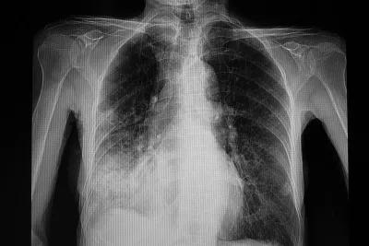
Dataset Tour 1: Healthcare & Climate
AI in Medical Imaging
Automated analysis of radiographic scans to rapidly identify respiratory conditions like pneumonia.
Climate Trend Forecasting
Harnessing decades of meteorological records to model and predict global environmental shifts.
● Problem Type: Classification
Source:paultimothymooney/chest-xray-pneumonia
Objective:Differentiate between "normal" lung scans and those indicating pneumonia from grayscale X-rays.
Value:Speeds up triage and supports radiologists in underserved regions.
● Problem Type: Regression
Source:berkeleyearth/climate-change-surface-temp
Objective:Predict future temperatures and quantify warming rates using historical station data.
Value:Provides empirical evidence for climate policy and adaptation planning.
Notes:
First stop: healthcare and climate. The first dataset uses chest X-rays to classify patients as either normal or having pneumonia—a classic classification problem. The second uses historical temperature data to forecast future climate trends—a regression problem. Both demonstrate how AI can turn raw data into actionable insights for critical global issues.

Slide 23

Dataset Tour 2: Finance & Sports
01 / Finance: Credit Card Fraud
02 / Sports: FIFA Player Ratings
Source:mlg-ulb/creditcardfraud Input:Anonymized transaction records Output:Binary label: Legit / Fraud
Source:stefanoleone992/fifa22 Input:Age, position, skills, etc. Output:Market value / Overall score
Core Challenge: Extreme Class Imbalance Only0.17%of transactions are fraudulent. This imbalance makes detection extremely hard, as missing a fraud case leads to significant financial loss.
Task Type: Regression & Ranking Map player attributes to a continuous score (regression) or determine player potential (ranking). This shows AI's application in sports analytics and value prediction.
Notes:
Next, we move to finance and sports. The credit card fraud dataset is a tough one—fraudulent transactions are extremely rare, making it an imbalanced classification problem. The FIFA dataset shows how AI can predict a player's market value based on their attributes, a regression or ranking task. These examples highlight AI's versatility across different industries.

Slide 24


Dataset Tour 3: Autonomous Driving
Data Repository
Source: prateekkarkera/self-driving-cars (Open Source)
Input / Output Schema
Input: RGB camera frames | Output: Annotated bounding boxes (class & coordinates)
Core AI Task
2D Object Detection: Simultaneously classify and localize multiple objects.
This dataset provides a first-person view of driving scenarios, complete with AI-generated bounding boxes that label critical road elements like vehicles and pedestrians.
Learning Objective
The primary dataset for our end-to-end AV Perception case study in this course.
Notes:
Our final dataset brings us back to our anchor case study: autonomous driving. This dataset contains road images with labeled bounding boxes around cars, pedestrians, and traffic lights. This is a classic object detection problem, and this is the kind of data we'll be working with to teach our virtual car to see.

Slide 25

What We Learned from the Datasets
AI’s potential spans nearly every domain, but every impactful project begins with answering three foundational questions that shape its direction, data needs, and ultimate value.
01. What is the Input?
02. What is the Output?
03. What Defines Success?
Identify the raw data fueling the model—whether it’s visual images, sensor readings, financial transactions, or unstructured text that forms the bedrock of your AI system.
Define the intended result: a classification label, a precise numerical prediction, a bounding box for object detection, or a coherent generated text/response.
Set measurable KPIs to gauge performance—such as 95% classification accuracy, a 40% reduction in fraud losses, or a 20% boost in predictive lead quality.
Once these questions are answered, you can align your data strategy, select the optimal model architecture, and build an AI solution that delivers clear, actionable value.
Notes:
What's the common thread across all these diverse datasets? Every AI project boils down to three fundamental questions. First, what is the input data? Second, what output do we want to produce? And third, how do we measure success? Mastering these three questions is the first step in defining any AI problem effectively.

Slide 26

AI as a Research Instrument
THE MOST IMPORTANT IDEA IN THIS CHAPTER
“AI is not just a subject to study — it is a tool to study with.”
Just as scientists once harnessed microscopes and telescopes to expand human knowledge, today’s researchers use AI models, curated datasets, and computational experiments as their new lenses of discovery, opening up frontiers across every academic and scientific discipline.
Formulate Questions
Curate Data
Apply Models
Interpret Results
Craft clear, testable research inquiries that align with AI’s analytical strengths.
Source, clean, or build high-quality datasets that are fit for your specific research hypothesis.
Select and implement appropriate AI architectures to process data and generate insights.
Analyze outputs critically, assess validity, and account for potential biases.
Goal:Become aliterate and capable AI researcher— you don’t need to build AI tools from scratch, but you do need to know how to use them effectively and ethically.
Notes:
This brings us to the most important idea of this chapter: AI is not just something we study; it's a tool we can use to study other things. Like the microscope for biology or the telescope for astronomy, AI is a new kind of research instrument. The goal of this book is to teach you how to use this instrument—to ask good questions, find the right data, apply the right models, and interpret the results.

Slide 27


Practice What You've Learned
AI Application Map
Kaggle Dataset Hunt
Research Question
EASY
MEDIUM
CHALLENGE
1. Choose a domain you’re passionate about (e.g., healthcare, education).
2. Find 3 real-world AI applications within it.
3. For each, define its input, output, and core value to society.
1. Visit Kaggle Datasets and filter by your chosen domain.
2. Select one intriguing dataset: Note its title and size.
3. Analyze: What type of AI problem can it solve? (e.g., prediction, classification)
1. Using your selected dataset, craft a specific, measurable research question.
2. Ensure it is answerable with the data provided.
3. Write down a 2-step plan to investigate this question.
Remember:The goal is to move from passive learning to active creation — these exercises bridge the gap between theory and practice.
Notes:
Now it's time to put your knowledge into practice. Here are three exercises to help you solidify what you've learned. Start by building your own AI application map. Then, dive into Kaggle to explore real datasets. Finally, challenge yourself to think like a researcher and formulate a specific question you could answer with that data. These exercises are designed to turn passive learning into active engagement.

Slide 28



Chapter 1 Recap
AI ⊃ ML ⊃ DL
AI is Everywhere
Perception is Key
Grasp the hierarchical relationship: Artificial Intelligence encompasses Machine Learning, which in turn includes Deep Learning as its specialized subset.
From streaming recommendations and medical diagnostics to fraud detection and self-driving cars, AI is deeply embedded in modern life.
Teaching machines to interpret the world visually—like cars 'seeing' the road—is the cornerstone of autonomous systems and computer vision.
Input, Output, Success
AI is a Research Tool
Frame every AI problem by defining three core elements: the raw data input, the desired model output, and the measurable metrics that define success.
Use AI like a scientist uses a microscope: not just as a technology, but as an instrument for discovery, exploration, and gaining new insights across disciplines.
Notes:
Let's quickly recap what we've covered in Chapter 1. We've clarified the relationship between AI, ML, and DL. We've seen that AI is already deeply integrated into our world across countless industries. We've focused on perception as our core case study. We've learned to frame any AI problem by asking about input, output, and success. And most importantly, we've embraced AI as a powerful new research tool.

Slide 29


What's Next? Looking Ahead to Chapter 2
In Chapter 2, we will learn how to transform a vague curiosity into a sharp, answerable research question—the critical foundation that shapes the entire trajectory of an AI investigation.
Evaluate Question Quality
Master the Question Ladder
Craft Your Own Questions
Learn to differentiate between overly broad, unanswerable questions and focused, specific ones that are feasible for AI research.
Climb from simple factual queries to medium interpretive questions, and finally to strong, analytical questions that drive discovery.
Apply the framework through hands-on exercises to draft and refine your own research questions for AI applications.
💡 Key Takeaway: A well-formed research question is the single most important determinant of success in AI research. It defines your scope, methodology, and the value of your findings.
Notes:
So, what's next? In Chapter 2, we'll tackle the most crucial step in any research project: asking the right question. We'll learn how to distinguish between good and bad research questions, use a framework called the "Question Ladder," and practice crafting our own. This is where the real journey of discovery begins.

Slide 30


Questions & Discussion
Thank You!
—— 探索新知，启迪未来 ——
Notes:
That concludes Chapter 1. Thank you for your attention. Now, I'd like to open the floor for any questions or discussion. What was the most surprising thing you learned today? Or is there any part you'd like to explore further?

